Slide 1
System and Network Administration
SSL/TLS and
Tunnels

Slide 2
Secure Systems
1. Security policy
What needs to be protected
Kinds / level of protection
Responsibilities
Auditing policy
3. Security mechanisms
cryptography
authentication
security protocols
2. Security environment
Physical environment
Physical security
Hardware, operating system
firewalls, etc
4. Monitoring and auditing procedures
monitor access
audit trails
feedback on failures, security breaches
containment & recovery

Slide 3
Security Protocols
In practice, no single mechanism is adequate to address all goals, so a mix of mechanisms will be required to enforce security policies.
A protocol is an orderly sequence of steps that two or more parties follow in order to accomplish some joint task
e.g. protocols for
authentication of participants in an exchange of messages
data integrity checks
Encryption is a mechanism that can be incorporated into security protocols

Slide 4
Secure Sockets Layer (SSL)
Transport Layer Security (TLS)
Application
SSL is a commonly-used protocol for managing the security of message transmission.
TLS is the IETF standard version of SSL.
SSL is a layer between the application and TCP layers
SSL
TCP
IP
Data Link

Slide 5
Symmetric vs Asymmetric Key
Symmetric key
Asymmetric key
Typically both share
same key
Two separate keys: a public and a private key
Typically faster x100!
Typically slower
Examples:
DES, IDEA, RC5, AES, …
Examples:
RSA, ElGamal Encryption, ECC…

Slide 6
Mechanisms to Protocols: Session Keys
Public Key Algorithms are ‘computationally intensive’
1000 times slower on average than symmetric systems.
Conventional Algorithms require secure key exchange
If the key is intercepted, confidentiality will be compromised
SO ...
Generate a symmetric ‘session key’
Used only for this communication session
Random number
Use public key to encrypt
Then use the session key to exchange data

Slide 7



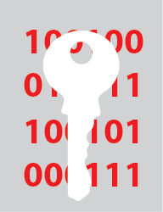

Session Keys
A single-use symmetric key used for encrypting all messages in a single series of related communications.
Limits the amount of data encrypted with a key to reduce the effectiveness of analysis.
Can be faster and more efficient than asymmetric encryption alone.
Symmetric key
User B's public key
Encrypted symmetric key
1
User A
User B
User B's private key
Decrypted symmetric key
2

Slide 8
SSL / TLS
HTTP using SSL (HTTPS:// in a URL) is now the standard mechanism for protecting data sent to and from websites across the Internet
Browsers have a collection of Certificates from various certificate authorities to use to authenticate websites
Sites can also generate “Self-Signed” Certificates that can be accepted by the user
Must use https:// in the URL request to signal the server that the browser wants to initiate a secure connection

Slide 9





The SSL/TLS Connection Process
1
Client sends request
Server responds with certificate
2
3
Encryption algorithm negotiated
4
Client sends session key encrypted with Public Key
Server returns session key encrypted with Public Key
5
Confidential message:
Requires Private Key to decrypt
Confidential message:
Requires Private Key to decrypt
6
Connection is encrypted using Session Key

Slide 10
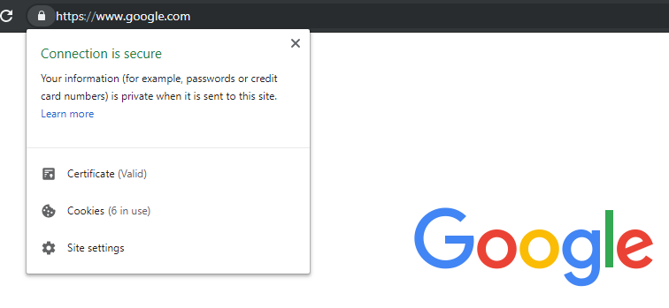
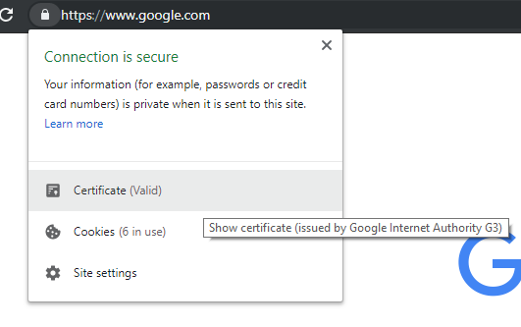
Example: Chrome
1
2

Slide 11
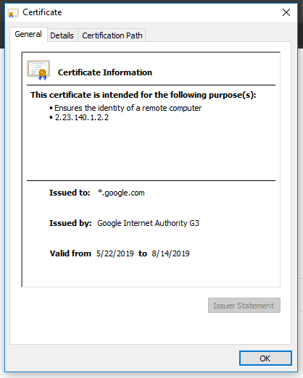
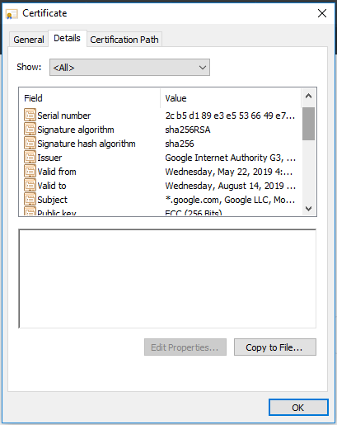
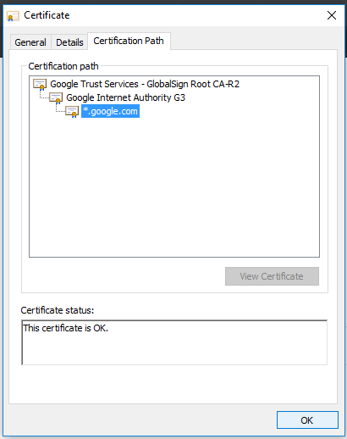
Example: Chrome
3
4
5

Slide 12




Secure Shell (ssh, scp, sftp)
A protocol used for secure remote access and secure transfer of data.
Consists of a client and server.
ssh for remote login sessions.
Provides secure copy (scp) and file transfer (sftp)
Entire session is encrypted.
Similar to using
telnet / ftp / tftp with stunnel
Session is encrypted
SSH Tunnel

Slide 13
Ports and Port Ranges
Port: The endpoint of a logical network connection.
Client computers connect to server programs through a designated port.
Port is a “Layer 4” concept – TCP header
All ports assigned are between the numbers 0 and 65535.
Port | Service | Secure | Port
20 | Telnet | SSH | 22
25 | SMTP | SMTPS | 465
80 | HTTP | HTTPS | 443
143 | IMAP | IMAPS | 993
389 | LDAP | LDAPS | 636
Port | Service
53 | DNS
67 | DHCP (server)
68 | DHCP (client)
587 | Submission

Slide 14




Slide 15
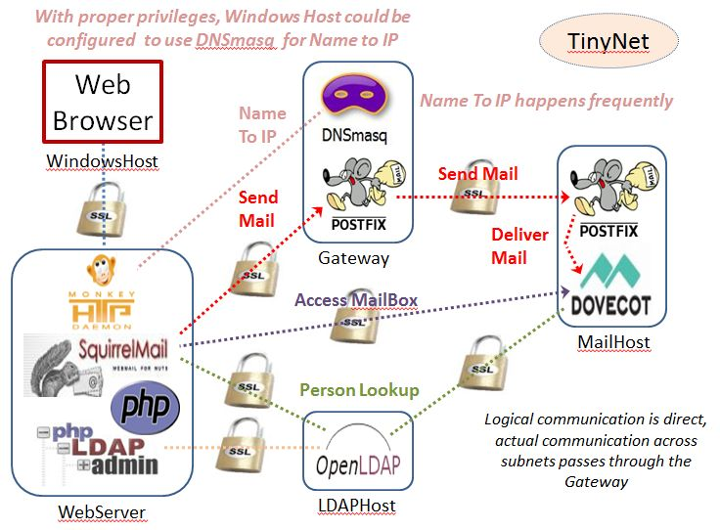
Configure Security

Slide 16
stunnel
We use stunnel rather than the native SSL capabilities of postfix, dovecot, and ldap because it is simpler to have one configuration and adapt it rather than munging all of the config files ...
and it demonstrates the concept of port forwarding.

Slide 17
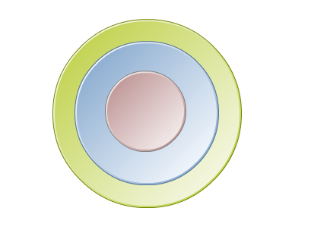


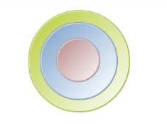
Tunneling
A data-transport technique in which a data packet is encrypted and encapsulated in another data packet.
Tunneling conceals information of the inside packet.
Hides user-encrypted data from carrier network.
Used in remote access protocols, typically in VPN.
Carrier Protocol
Encapsulating Packet
Original Packet

Slide 18
Encapsulation
Network devices at both ends of the tunnel, called tunnel interfaces, encrypt and encapsulate outgoing packets and reopen and decrypt incoming packets.
Routers along the way do not parse the payload (the inner packet); they only parse the outer packet as they forward it towards the tunnel endpoint.
Upon reaching the tunnel endpoint, encapsulation is removed and the payload is passed along to its ultimate destination.

Slide 19
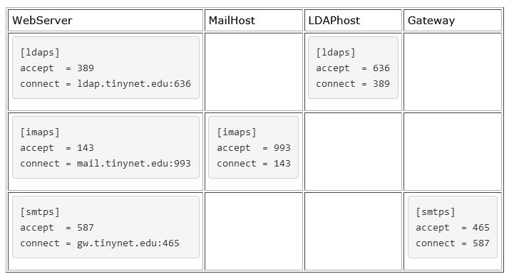
Our port forwarding scheme is simple. We just need to configure the listening (accept) port and the forwarding (connect) port for each service, depending on the role as a client or server.
Plain from server
Encrypyed from stunnel
Plain to server
Encrypyed to stunnel
So, to check our mail [imaps], the request is received by the client-side stunnel on port 143, stunnel does the encryption, and then sends it off to the MailServer. The server-side stunnel receives the request on port 993, unencrypts it, and passes it to Dovecot via port 143. Responses work the same way, in reverse.

Slide 20
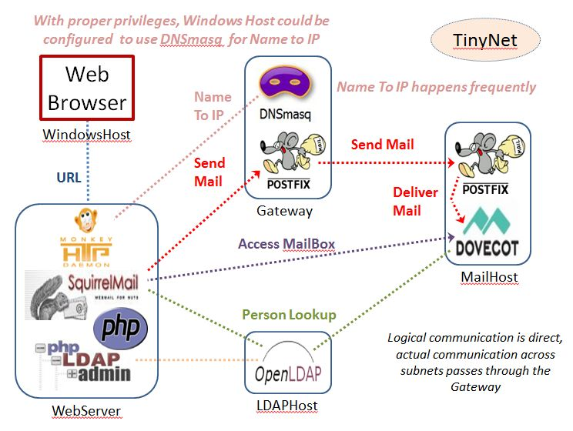
https
443
http
80
smtps
465
smtp
25
smtp
587
smtps
465
imap
143
imaps
993
ldaps
636
ldaps
636
ldap
389
ldap
389

Slide 21
stunnel
Our stunnel configuration is low-security, in the sense that it does not check the validity of the key
Any key is good for encryption ... But not every key can be trusted
there is a good discussion of trust vs. security at https://security.stackexchange.com/questions/112768/why-are-self-signed-certificates-not-trusted-and-is-there-a-way-to-make-them-tru
We use the same key on every server, because it is all within the site – More Convenience, Less Security

Slide 22
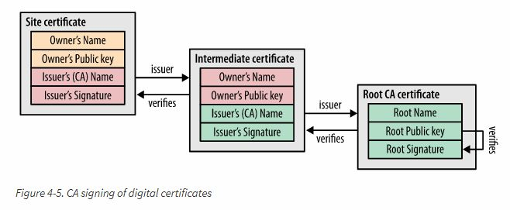
‘’ A self-signed certificate is like making a gold-colored badge looking thing in your home and then going around showing it to people saying you're a police officer. Maybe you can pull that trick with members of your family who accept that you're in charge, but if you want to be a real, public, law enforcement official, you have to be trusted by a central authority that everyone else trusts, like the government of your town or city or state. Otherwise, you're just impersonating a police officer and people would be wise to distrust you.’’ – Todd Wilcox Feb 4 '16 at 16:41
https://hpbn.co/transport-layer-security-tls/

Slide 24
Virtual Private Networks
stunnel and native capabilities are fine for per-service security, but what if we want to secure all communications between clients and servers?
What if we need to provide secure remote access to a lot of different applications?
Best answer: a “Virtual Private Network” (VPN)

Slide 25






Virtual Private Networks
A method of extending a private network by tunneling through a public network like the Internet.
Provides secure connections between endpoints.
Encapsulates and encrypts data through the tunnel.
VPN protocols provide tunneling and encryption services.
Private Network

Slide 26



VPNs and Wireless
Open wireless networks are a major risk.
Attackers can compromise communications.
If forced to use open wireless, tunnel through with a VPN.
Can encrypt data even when using an insecure wireless hotspot.
Use a strong tunneling protocol like IPSec.
Insecure Public Wi-Fi
VPN Tunnel

Slide 27

VPN Concentrators
A single device that incorporates encryption and authentication to handle a large number of VPN tunnels.
Can accommodate remote access or site-to-site.
Common tunneling protocols:
IPSec (site-to-site)
SSL/TLS (remote access)
Private Network
A
Private Network
B

Slide 28
IPSec
A "kernel space" VPN uses the secure version of IP (IPSec) to encrypt the data in every packet before it is sent. This works for both IPv4 and IPv6 networks.
IPSec actually consists of three main protocols:
IPsec Authentication Header (AH),
IPsec Encapsulating Security Payload (ESP), and the
IPsec Internet Key Exchange (IKE).
which are described in RFC4301 to RFC4309, plus 27 additional RFCs to clarify and update.

Slide 29
OpenVPN
OpenVPN is a full-featured SSL VPN which can accomodate a wide range of configurations
IP packets are encrypted and encapsulated in UDP, and sent through a TUN or TAP device to a matching device on a remote host.
The remote host receives, decrypts, authenticates, and de-encapsulates the packets, pumping the payload of the UDP packet into the stack
You can apply firewall rules to tun and tap interfaces in the same way that you can apply them to ethernet interfaces.

Slide 30
VPN Configuration
The two major techniques for VPN networking are routing (tun device) and bridging (tap device).
The VPN essentially links a local tun or tap device with a remote one of the same type.
Rather being connected to a wire, the driver connects to “user space”, where a program can open the device just like a file and read and write packets from and to it.

Slide 31
tun or tap interface?
Routing uses separate subnets and setting up routes between them.
A tun interface is a device driver that that looks like point-to-point network hardware to the operating system
Routes must be set up linking each subnet.
Better scalability

Slide 32
tun or tap interface?
Bridging is a technique for creating a virtual, wide-area ethernet LAN, running on a single subnet.
A tap interface emulates ethernet rather than point-to-point.
Allows software that depends on LAN broadcasts such as Windows NetBIOS file sharing and printer sharing to work.
Less efficient than routing (all that broadcast traffic)
Does not scale well.

Slide 33
TLS or Static Key mode?
TLS mode allows an OpenVPN server to allocate addresses from a pool to clients similar to a DHCP server
The tradeoff here is that every client needs to have its own certificate – Less IP management, More CA duties
In Static-Key mode two OpenVPN peers share the same key
We need xinetd to establish a client/server relationship
The tradeoff here is Less CA duties, More IP management
CA duties require planning and control - can be time consuming

